Slide 1
Lexical Analysis
Chapter 2 – part 1
Dr G Sudha Sadasivam
Prof & Head,CSE, PSGCT

Slide 2
Agenda
Role of LA
Terms related
Scanner + parser
RE and regular definitions
Input buffering – single and dual buffers

Slide 3
Review: Compiler Phases:
Source program
Lexical analyzer
Front End
Syntax analyzer
Symbol table
manager
Semantic analyzer
Error handler
Intermediate code generator
Code optimizer
Backend
Code generator

Slide 4
Lexical Analysis
Lexical analyzer: reads input characters and produces a sequence of tokens as output (nexttoken()).
Trying to understand each element in a program.
Token: a group of characters having a collective meaning.
const pi = 3.14159;
Token 1: (const, -)
Token 2: (identifier, ‘pi’)
Token 3: (=, -)
Token 4: (realnumber, 3.14159)
Token 5: (;, -)

Slide 5
Role of Lexical Analyser
Read input characters
To group them into lexemes
Produce as output a sequence of tokens
input for the syntactical analyzer
Interact with the symbol table
Insert identifiers
to strip out
Comments
whitespaces: blank, newline, tab, …
other separators; compaction of consecutive white spaces into one
to correlate error messages generated by the compiler with the source program
to keep track of the number of newlines seen
to associate a line number with each error message

Slide 6
Interaction of Lexical analyzer with parser
token
Source
program
Lexical
analyzer
parser
Nexttoken()
symbol
table

Slide 7
Some terminology:
Token: a group of characters having a collective meaning. A lexeme is a particular instant of a token.
E.g. token: identifier, lexeme: pi, etc.
pattern: the rule describing how a token can be formed.
E.g: identifier: ([a-z]|[A-Z]) ([a-z]|[A-Z]|[0-9])*
Lexical analyzer does not have to be an individual phase. But having a separate phase simplifies the design and improves the efficiency and portability.

Slide 8
Why to separate scanner and parser phases?
Simplicity of design
Separation of lexical from syntactical analysis -> simplify at least one of the tasks
e.g. parser dealing with white spaces -> complex
Cleaner overall language design
Improved compiler efficiency
Liberty to apply specialized techniques that serves only lexical tasks, not the whole parsing
Speedup reading input characters using specialized buffering techniques
Enhanced compiler portability
Input device peculiarities are restricted to the lexical analyzer (poratble)

Slide 9
Lexeme, pattern, token
Lexeme
a sequence of characters in the source program matching a pattern for a token eg… ( total = a+ b) …. Total,=,a,+,b
Pattern
description of the form that the lexeme of a token may take
◦ e.g. Id = {[a-z][a-z,0-9]*}
Token - pair of:
◦ token name – abstract symbol representing a kind of lexical unit <id,ptr> -- attb – value pair

Slide 10
Two issues in lexical analysis.
How to specify tokens (patterns)?
How to recognize the tokens giving a token specification (how to implement the nexttoken() routine)?
How to specify tokens:
all the basic elements in a language must be tokens so that they can be recognized.
Token types: constant, identifier, reserved word, operator and misc. symbol.
Tokens are specified by regular expressions.
main() {
int i, j;
for (I=0; I<50; I++) {
printf(“I = %d”, I);
}
}

Slide 11
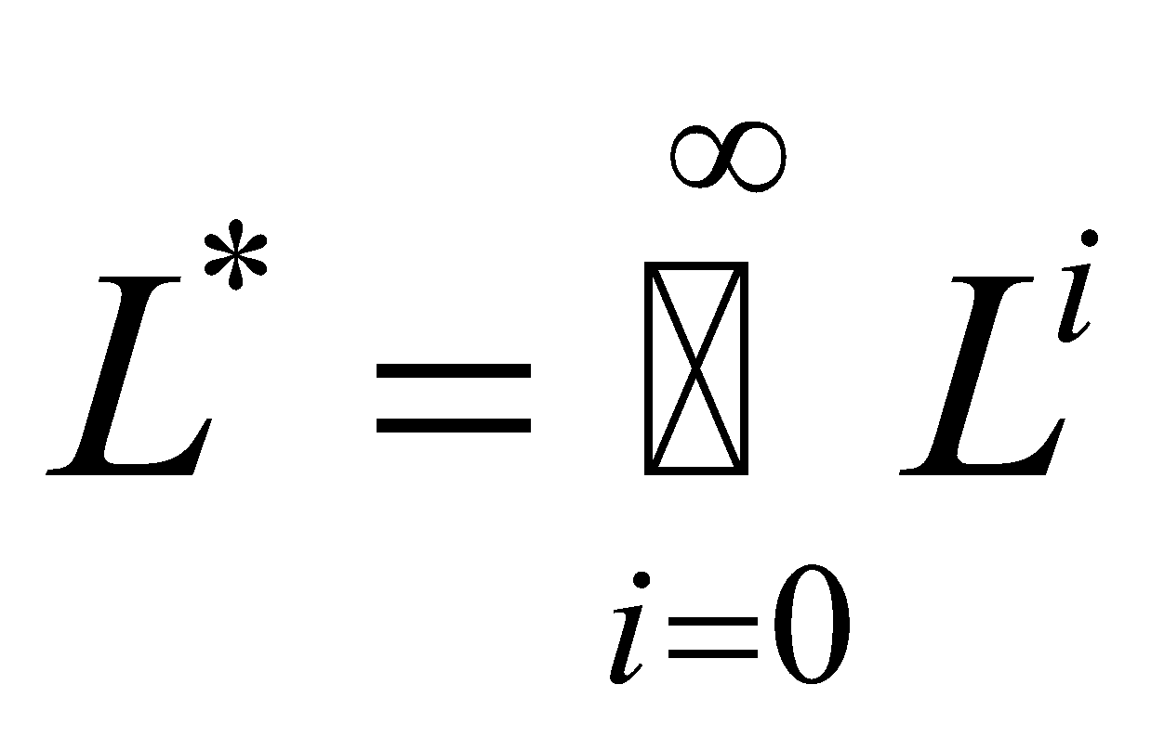
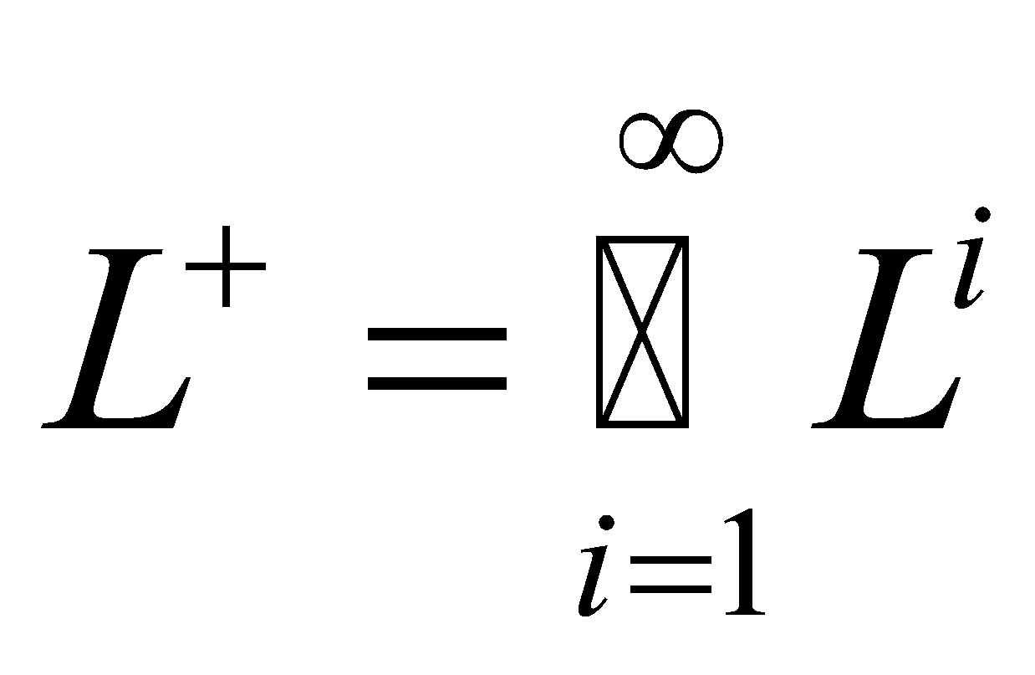
Some definitions
alphabet : a finite set of symbols. E.g. {a, b, c}
A string over an alphabet is a finite sequence of symbols drawn from that alphabet (sometimes a string is also called a sentence or a word).
A language is a set of strings over an alphabet.
Operation on languages (a set):
union of L and M, L U M = {s|s is in L or s is in M}
concatenation of L and M
LM = {st | s is in L and t is in M}
Kleene closure of L,
Positive closure of L,
Example:
L={aa, bb, cc}, M = {abc}

Slide 12



Formal definition of Regular expression:f
Given an alphabet ,
(1) is a regular expression that denote { }, the set that contains the empty string.
(2) For each , a is a regular expression denote {a}, the set containing the string a.
(3) r and s are regular expressions denoting the language (set) L(r ) and L(s ). Then
( r ) | ( s ) is a regular expression denoting L( r ) U L( s )
( r ) ( s ) is a regular expression denoting L( r ) L ( s )
( r )* is a regular expression denoting (L ( r )) *
Regular expression is defined together with the language it denotes.

Slide 13
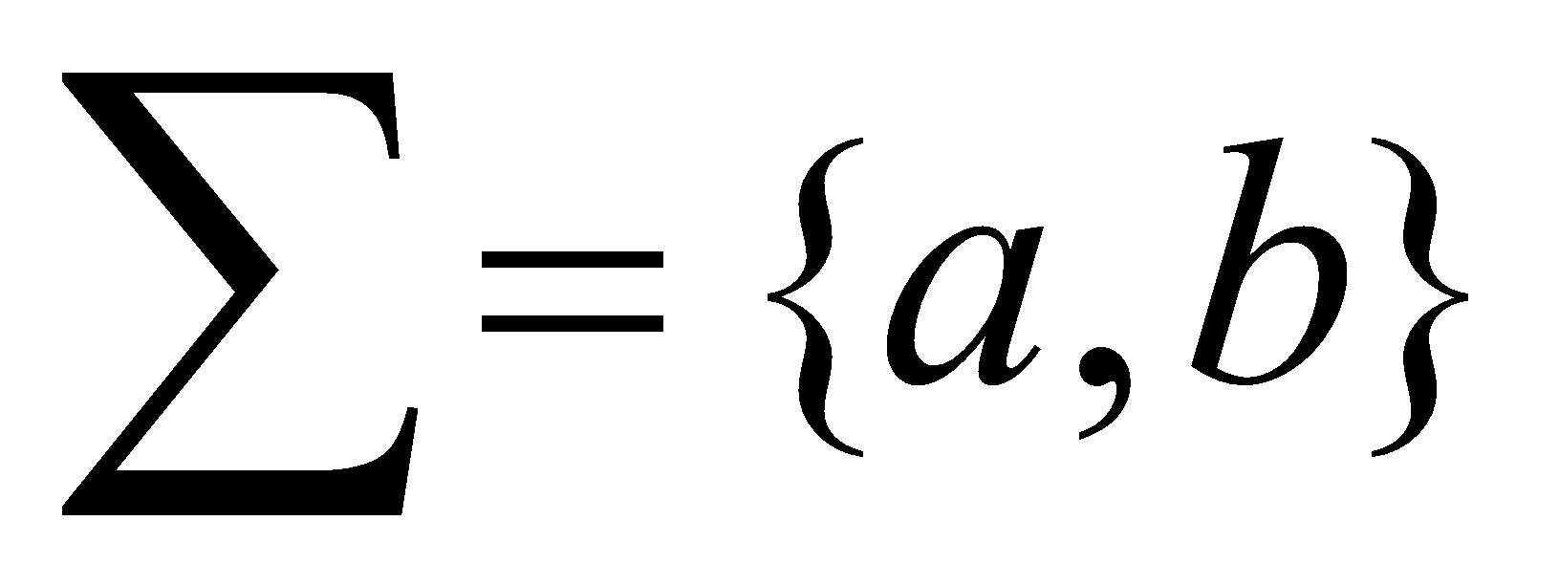
Examples:
let
a | b
(a | b) (a | b)
a *
(a | b)*
a | a*b
We assume that ‘*’ has the highest precedence and is left associative. Concatenation has second highest precedence and is left associative and ‘|’ has the lowest precedence and is left associative
(a) | ((b)*(c ) ) = a | b*c

Slide 14
Regular definition.
gives names to regular expressions to construct more complicate regular expressions.
d1 -> r1
d2 ->r2
…
dn ->rn
example:
letter -> A | B | C | … | Z | a | b | …. | z
digit -> 0 | 1 | 2 | 3 | 4 | 5 | 6 | 7 | 8 | 9
identifier -> letter (letter | digit) *
more examples: integer constant, string constants, reserved words, operator, real constant.

Slide 15
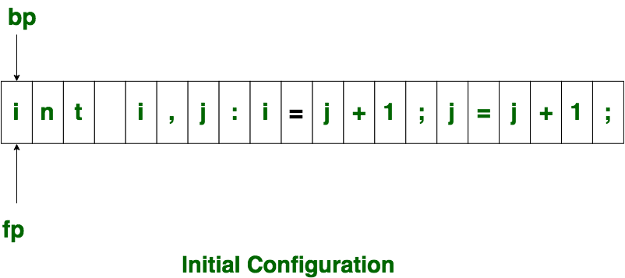
Input Buffering
The lexical analyzer scans the input from left to right one character at a time. It uses two pointers begin ptr(bp) and forward to keep track of the pointer of the input scanned.
Initially both the pointers point to the first character of the input string as shown below

Slide 16
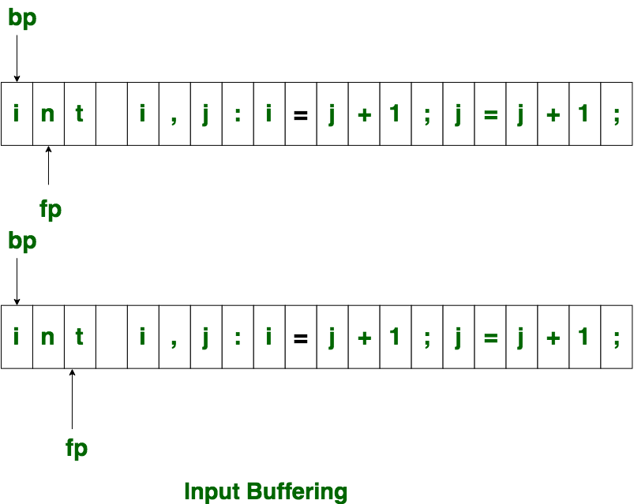
fp moves until a blank is encountered, it comes back and identifies int as a token.

Slide 17
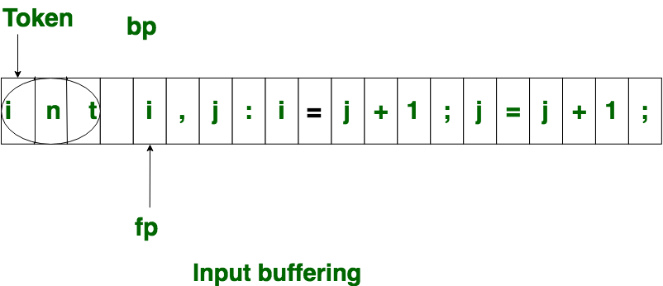
then both the begin ptr(bp) and forward ptr(fp) are set at next token.
Single buffer: In this scheme, only one buffer is used to store the input string but the problem with this scheme is that if lexeme is very long then it crosses the buffer boundary, to scan rest of the lexeme the buffer has to be refilled, that makes overwriting the first of lexeme.

Slide 18
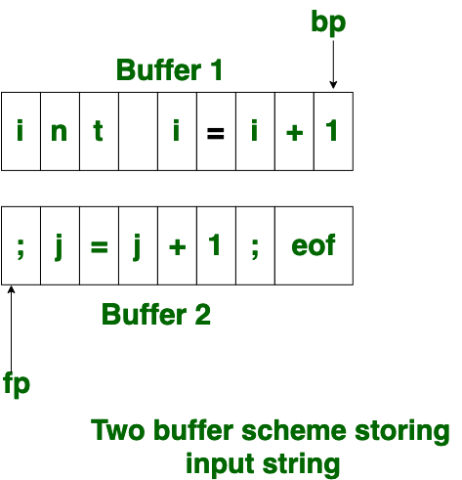
Two buffer scheme
the first buffer and second buffer are scanned alternately
to identify, the boundary of first / second buffer end of buffer character should be placed at the end first / second buffer.
eof character introduced at the end is calling Sentinel which is used to identify the end of buffer.

